Slide 1
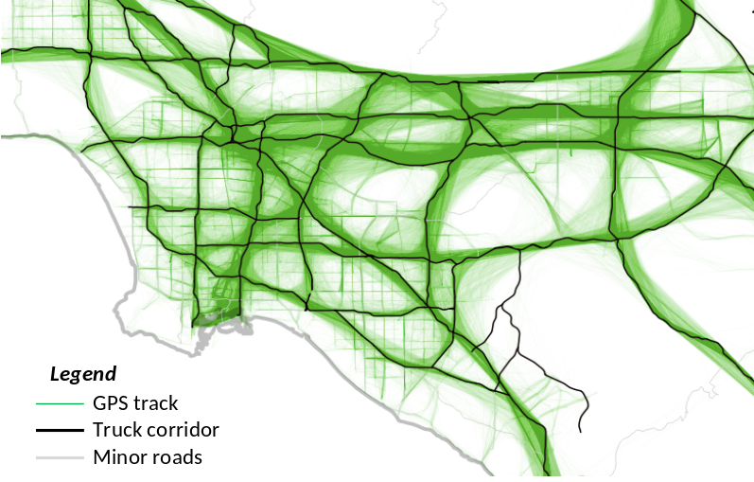
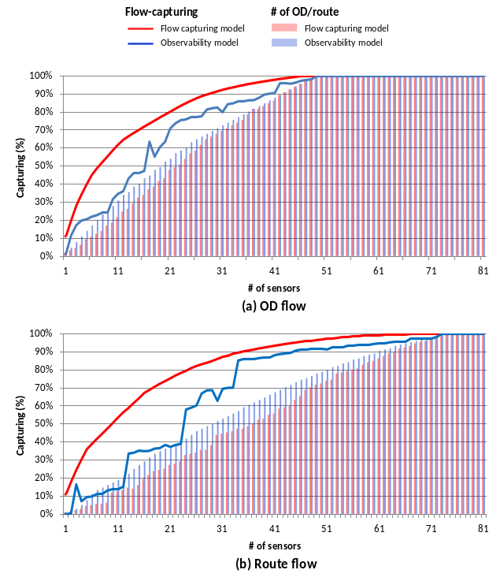
A Sensor Location Decision Model for Truck Flow Measurement: Kyung (Kate) Hyun, UC Irvine
 | Previous studies
Goal | Identifiability of ODs and routes (i.e., Observability problem) Find locations that observe more ODs and routes
Focus | General traffic
Proposed sensor location model
Maximum OD and route flow capturing (i.e., flow capturing model) Find locations that are more utilized by trucks
Truck traffic
Applied to real network extracted from GPS trajectories

Slide 2
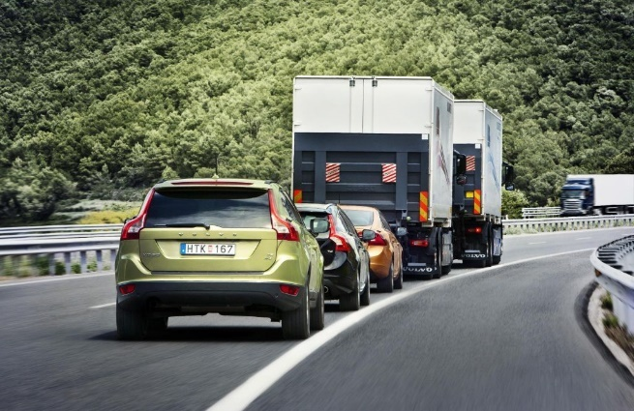
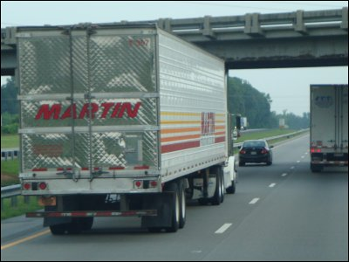
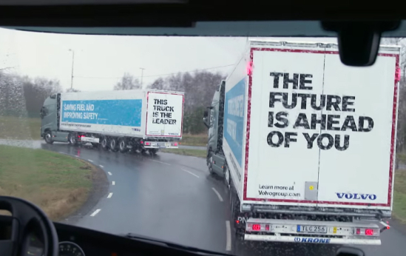
Assessing crash risks considering vehicle interactions with trucks using point detector data
Introduces traffic measures at individual vehicle level to capture vehicle interactions between trucks and non-trucks using point detector data
Analyzed how the measures affect crash risk under different traffic conditions
Three types of vehicle flowing cases
NT: Non-truck following Truck
TN : Truck following Non-truck
TT : Truck following Truck

